Slide 1
Household power consumption prediction and Forecasting
The study includes time series prediction of household
electricity consumption.
Submitted by: Sushmitha R

Slide 2
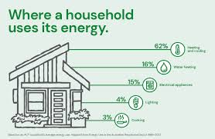
Contents
Introduction
Objectives
Data description
Data preparation
EDA
Time series forecasting models
Feature engineering
Model evaluation and tuning
Future consumption prediction

Slide 3
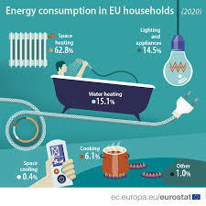
Introduction
This internship project “2” is focused on leveraging Python for time series prediction of household electricity consumption.
To build Time series model and evaluate metrics
To predict future consumption
Objectives

Slide 4
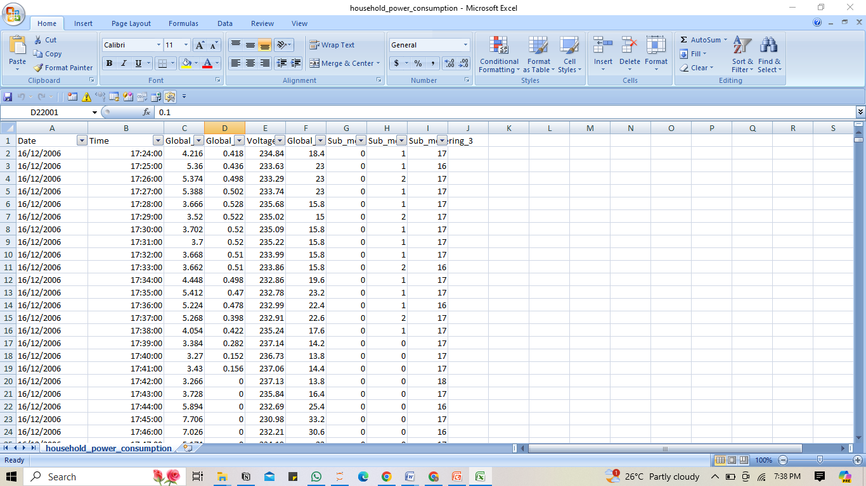
Data description
1. Date: Date of the electricity consumption recording.
2. Time: Time of the electricity consumption recording.
3. Global_active_power: Total active power consumed by the household.
4. Global_reactive_power: Total reactive power consumed by the household.
5. Voltage: Voltage level during the electricity consumption period.
6. Global_intensity: Total current intensity consumed by the household.
7. Sub_metering_1: Electricity consumption in sub-metering 1 (e.g., kitchen).
8. Sub_metering_2: Electricity consumption in sub-metering 2 (e.g., laundry).
9. Sub_metering_3: Electricity consumption in sub-metering 3 (e.g., water heater).

Slide 5
Data preparation
Null values = No nulls
Converted into a proper data type
'Global_active_power'] to (float)
'Global_reactive_power‘ to (float)
'Voltage’ to (float)
'Global_intensity to (float)
'Sub_metering_1’ to (float)
'Sub_metering_2’ to (float)
‘Date and Time’ to (datetime )
Outliers check – Filtered outliers
Normalization is done to bring the data into the same scale (0,1)

Slide 6
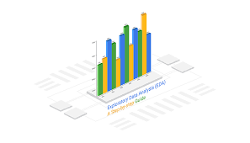
Exploratory data analysis -Distribution, Visualizations

Slide 7
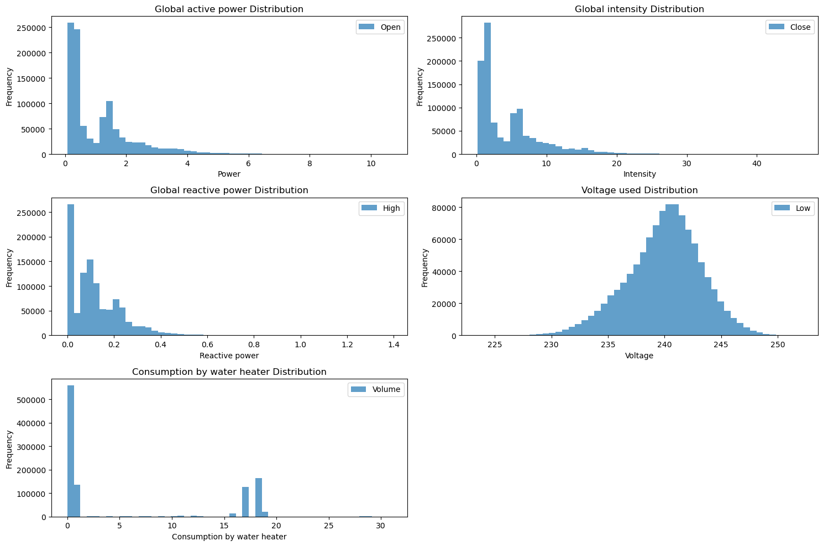
Data Distribution
The data distributions reveal key insights: Global active power and global intensity are right-skewed, indicating most consumption values are low with occasional high spikes. Reactive power follows a similar pattern but with generally lower values. The voltage distribution is approximately normal, showing stable voltage levels around 240 volts. Consumption by the water heater frequently registers zero, indicating many periods of no usage with occasional high consumption peaks. These patterns highlight variability in consumption and stability in voltage, essential for accurate forecasting and anomaly detection.

Slide 8
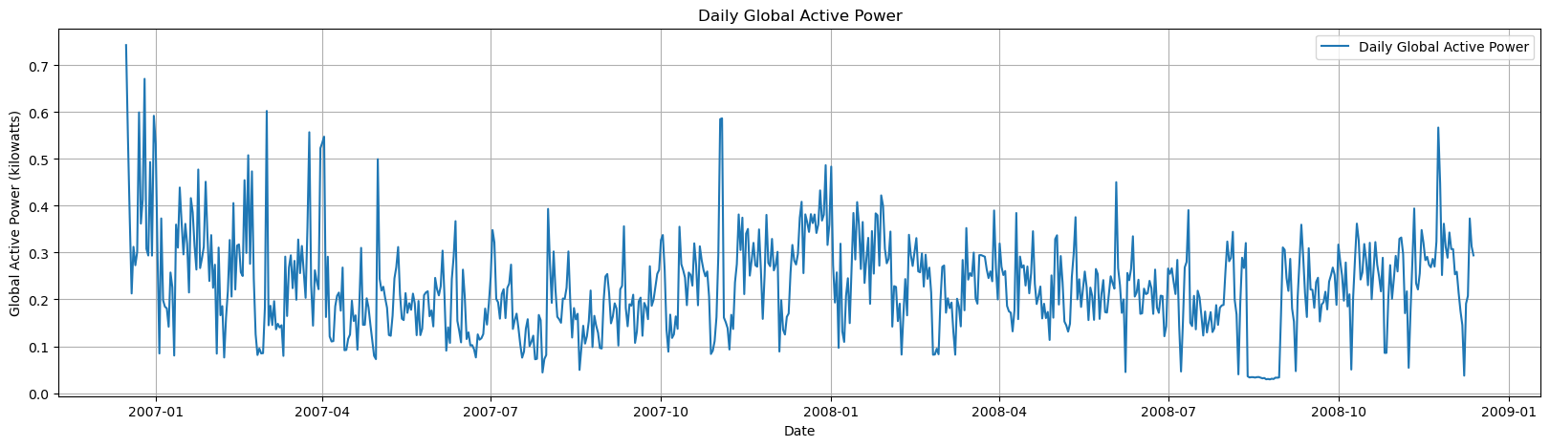
Visualization of Daily consumption of electricity of household
This graph gives us a impression of increasing and decreasing trend but we can see a pattern over here exactly during the half of the year and end of the year and there is a spike in the consumption of electricity while the beginning of each year we can see a reduced consumption of electricity.

Slide 9
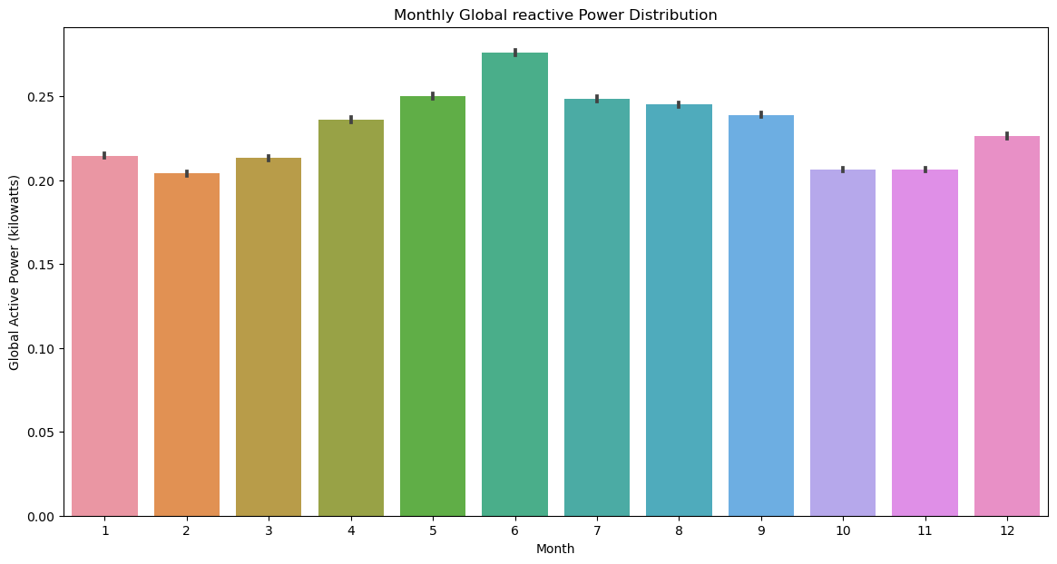
Monthly consumption of electricity by household

Slide 10
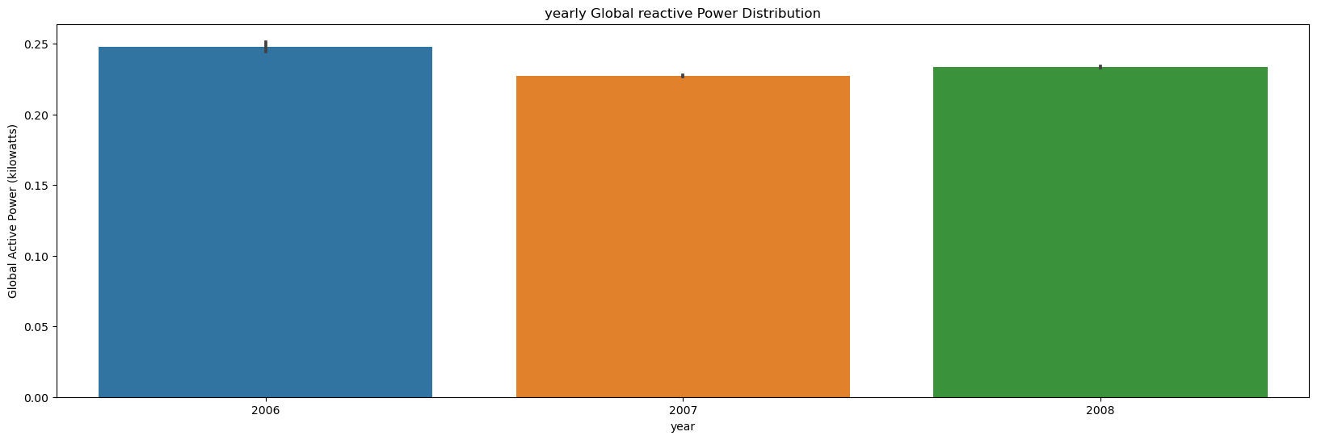
Yearly consumption of electricity by household
2006 has recorded the highest consumption of electricity by household and reduced usage in 2007 and slight increase in the next year(2008)

Slide 11
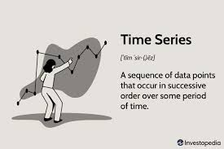
Time series decomposition - Trend, Seasonality, Random fluctuations

Slide 12
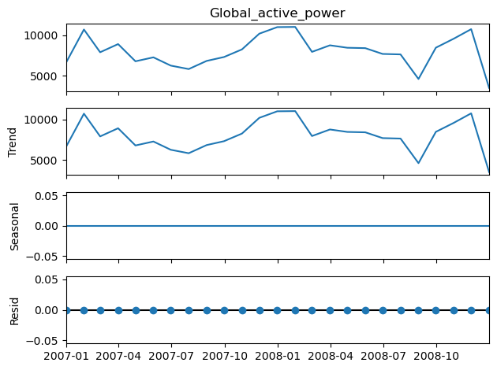
Time series Decomposition resampled to monthly
This decomposition says that there is no trend and seasonality in the electricity consumption, which also states the data is stationary.

Slide 13
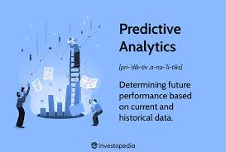
Predictive modelling - ARIMA - SARIMA

Slide 14
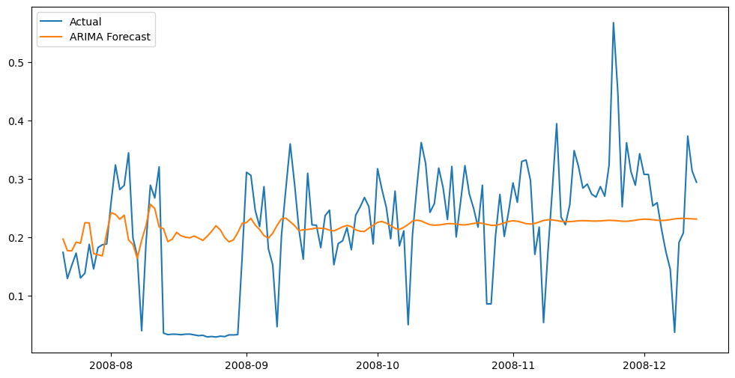
ARIMA model
The ARIMA model's RMSE score of 0.0957 indicates a relatively low error in the model's predictions compared to the actual values. This low RMSE score suggests that the model's predictions are close to the actual electricity consumption values, indicating its effectiveness in forecasting future values.

Slide 15
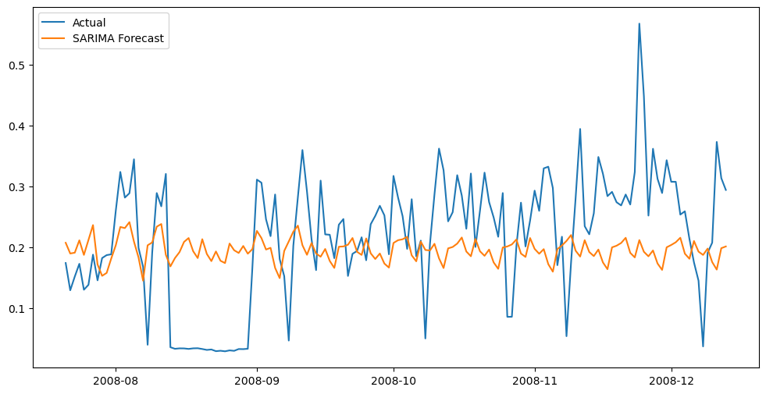
SARIMA Model
The RMSE score of 0.1053 indicates that, on average, the SARIMA model's forecasts differ from the actual values by approximately 0.1053 units.

Slide 16
Comparision between ARIMA and SARIMA model
ARIMA RMSE (0.0957): This lower score indicates that the ARIMA model has a slightly better fit to the data, with more accurate predictions compared to the actual values.
SARIMA RMSE (0.1053): This slightly higher score suggests that while the SARIMA model is still performing well, it has a marginally higher prediction error compared to the ARIMA model.
In summary, both models perform well in forecasting electricity consumption, but the ARIMA model has a slight edge over the SARIMA model in terms of prediction accuracy as indicated by the lower RMSE score.

Slide 17

Feature engineering

Slide 18
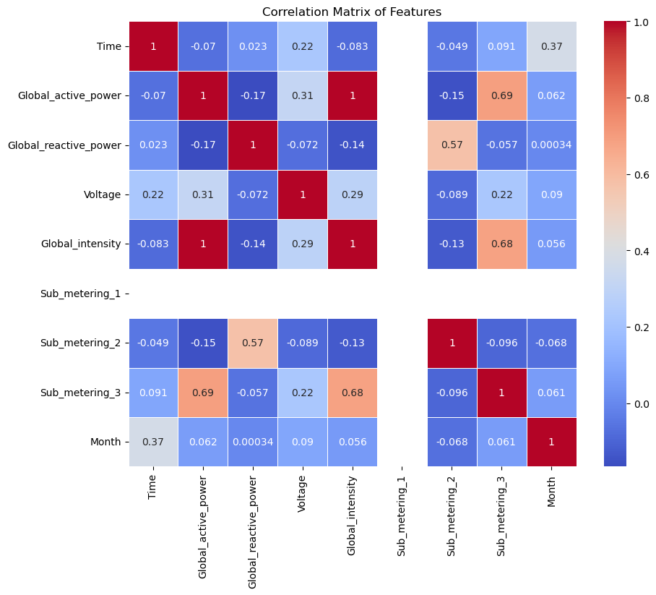
Correlation matrix
From the correlation plot we get to know that the features with high correlation are “sub meetering 3”,”Global intensity”

Slide 19
Created rolling statistics features
df['rolling_mean_3'] = df['Global_active_power'].rolling(window=3).mean()
df['rolling_mean_7'] = df['Global_active_power'].rolling(window=7).mean()
df['rolling_std_7'] = df['Global_active_power'].rolling(window=7).std()

Slide 20
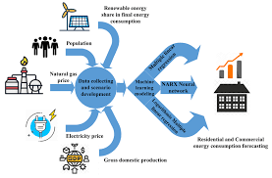
Future consumption prediction

Slide 21
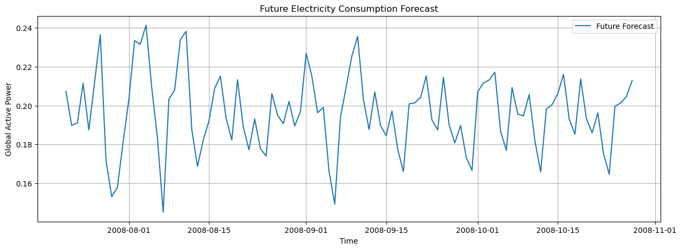
Forecasting using SARIMA model

Slide 22
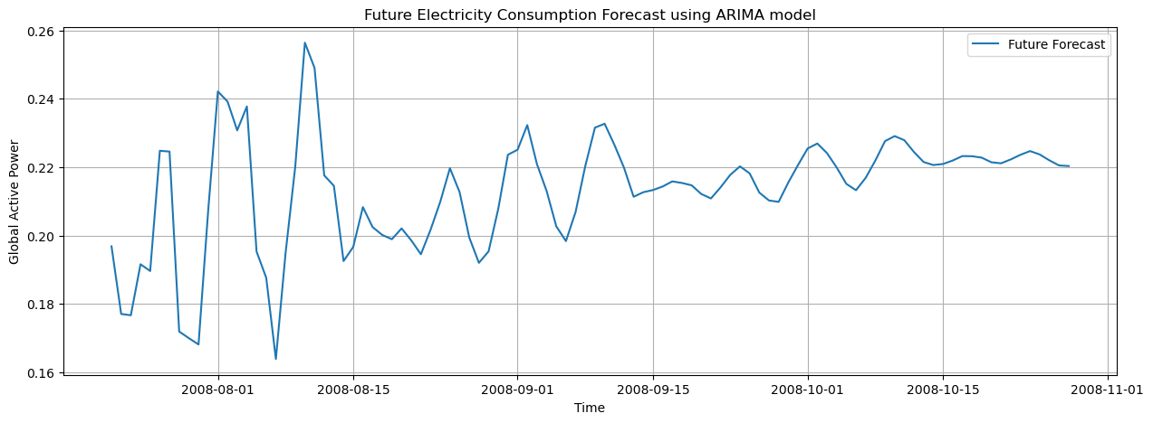
Forecasting using ARIMA model

Slide 23
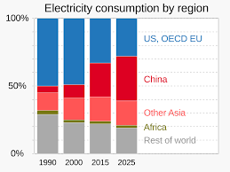
Summary
Data preparation like outlier removal and normalization is done for accuracy while predicting
Comparatively between ARIMA and SARIMA forecasting we can go with ARIMA forecasting technique as the accuracy of its prediction is quite better than SARIMA.

Slide 24
Thank you

